Slide 1
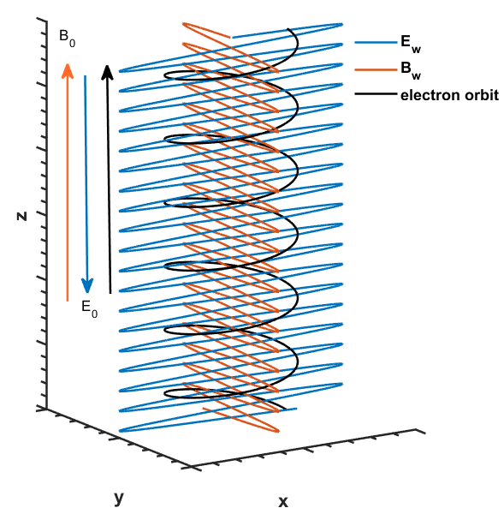
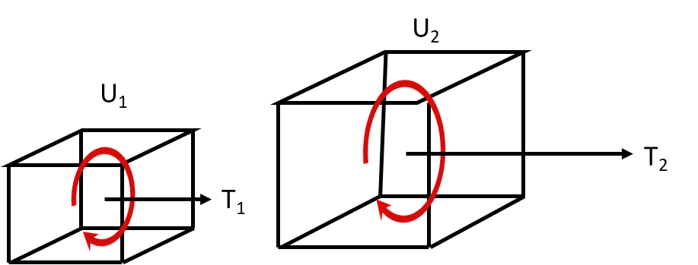
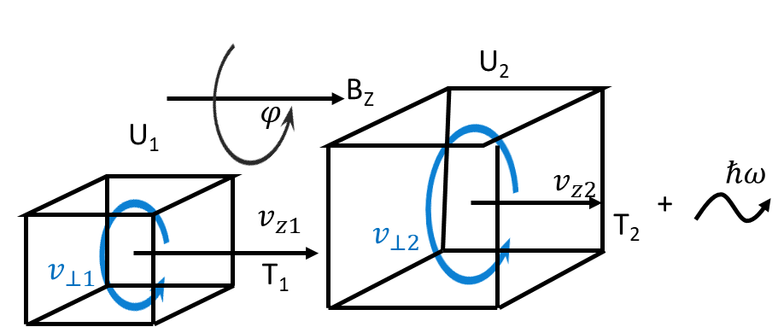

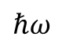
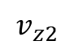
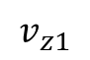


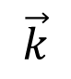
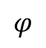
U₂
$$\vec{k}$$
B_{Z}
$$φ$$
U₁
$$v_{z2}$$
$$ℏω$$
$$v_{z1}$$
+
$$v_{⊥2}$$
T₂
$$v_{⊥1}$$
T₁
B_{Z}

Slide 2
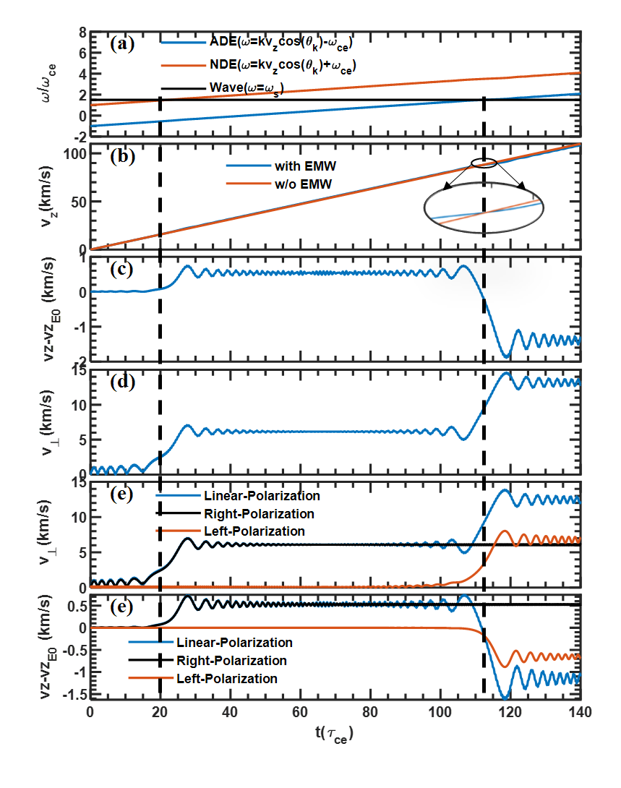
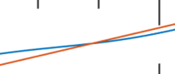

Slide 3
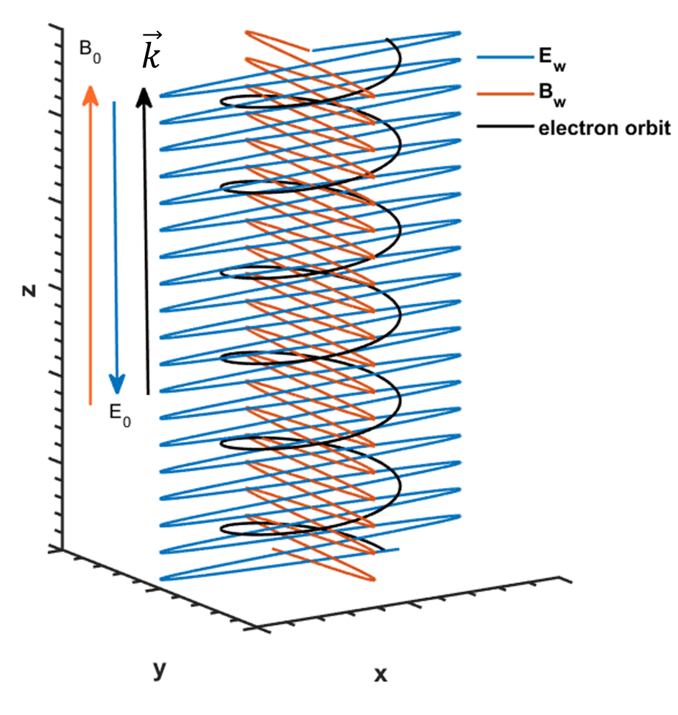


Slide 4
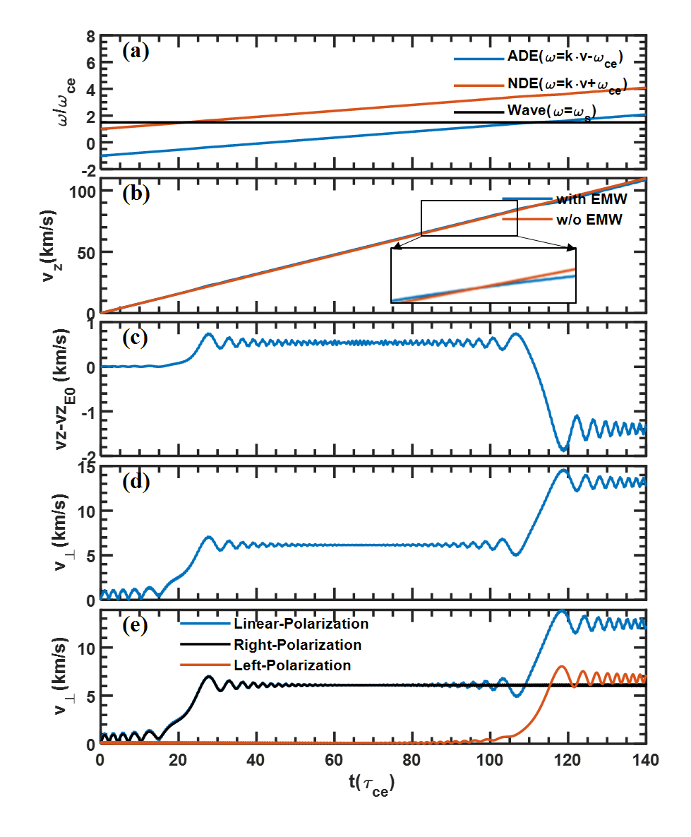

Slide 5
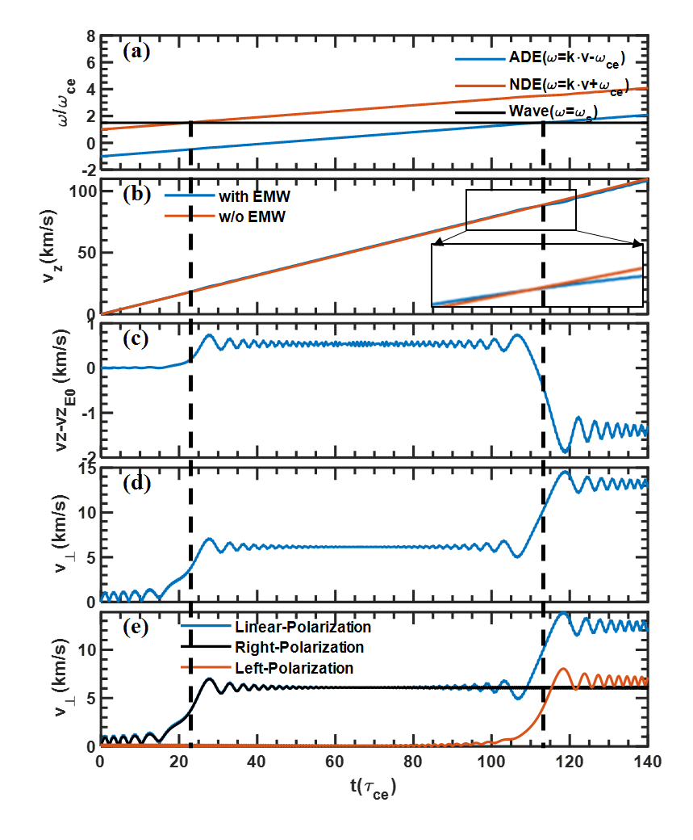
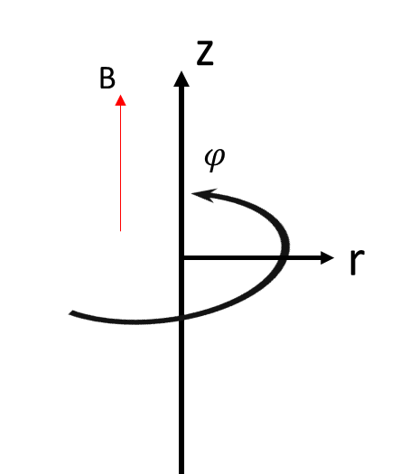
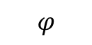
z
B
$$φ$$
r

Slide 6
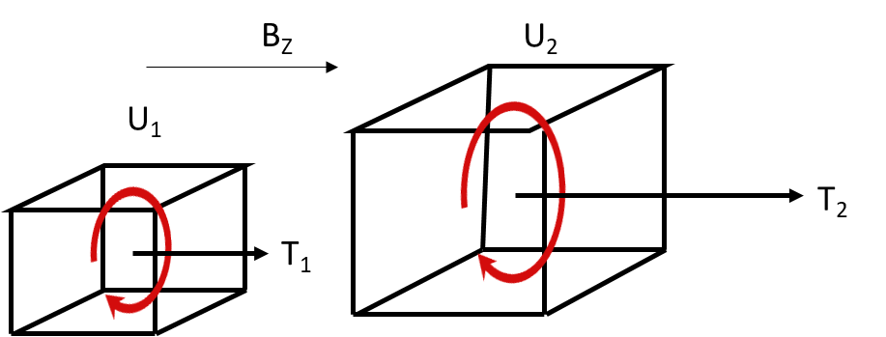
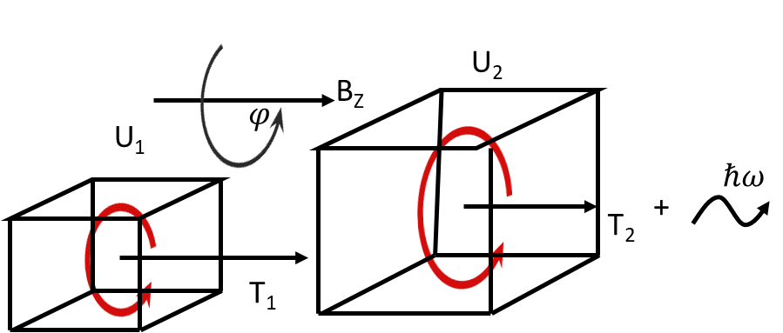
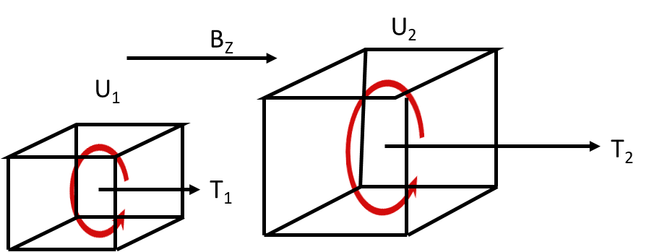

Slide 7

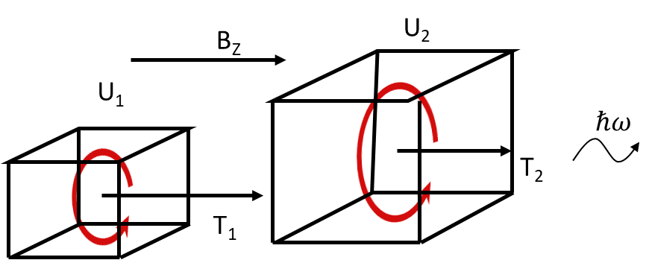


Slide 8
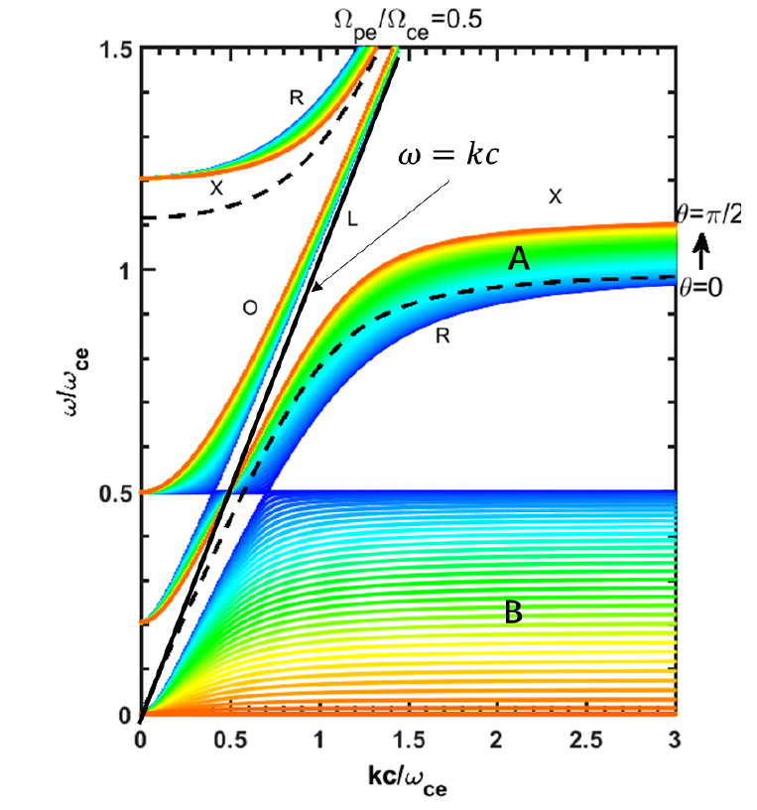

Slide 9
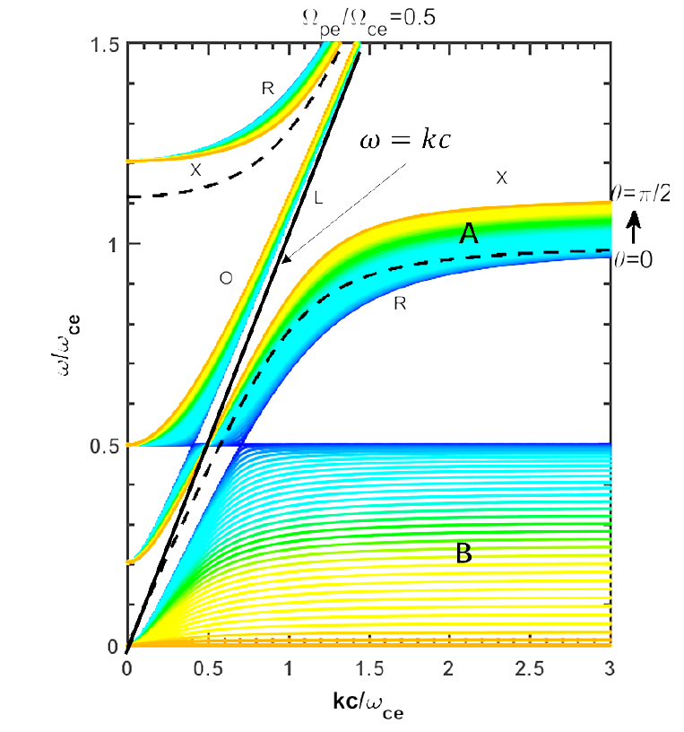

Slide 10
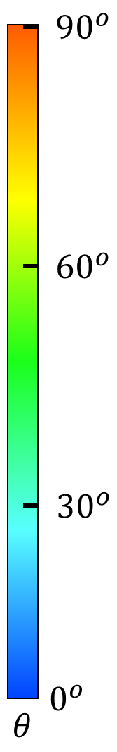
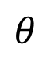
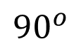
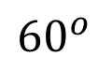
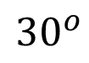
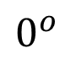
$${90}^{o}$$
$${60}^{o}$$
$${30}^{o}$$
$$0^{o}$$
$$θ$$

Slide 11
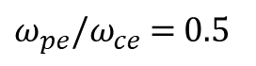
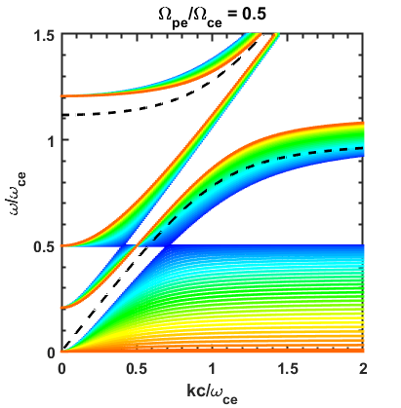
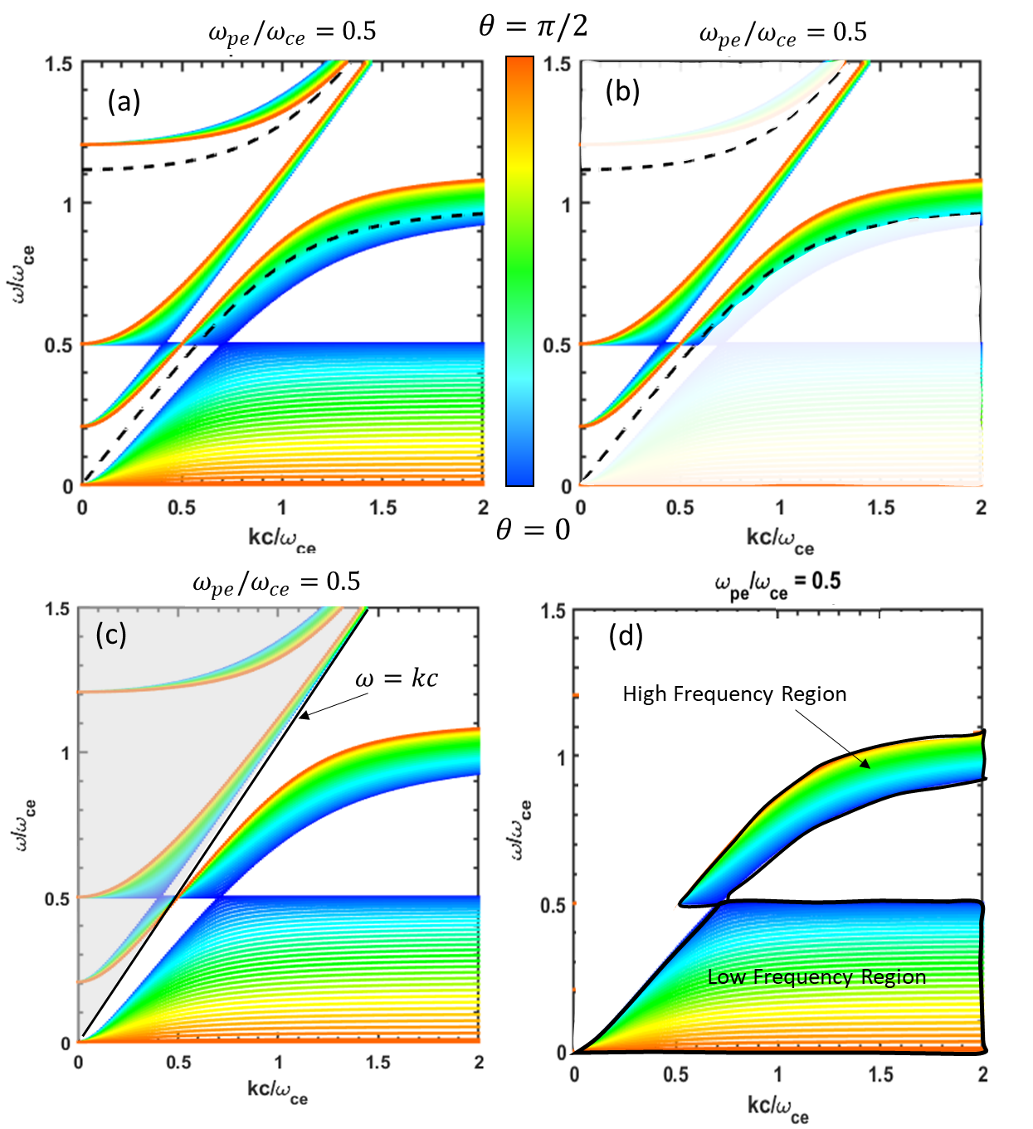
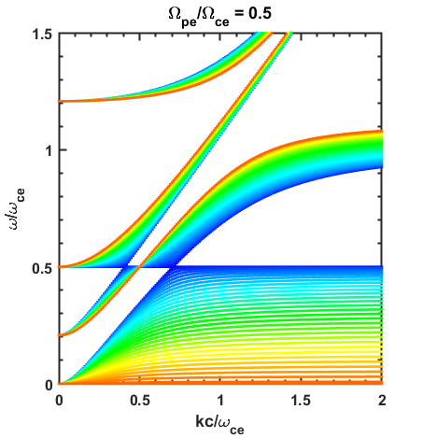


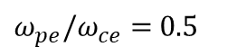
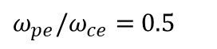
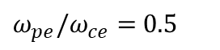
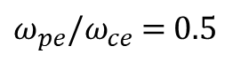
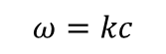
$ω_{pe}/ω_{ce}$ $=$ $0.5$
$ω_{pe}/ω_{ce}$ $=$ $0.5$
$ω_{pe}/ω_{ce}$ $=$ $0.5$
(a)
(b)
$ω_{pe}/ω_{ce}$ $=$ $0.5$
$ω_{pe}/ω_{ce}$ $=$ $0.5$
(c)
(d)
$$ω=kc$$
High Frequency Region
Low Frequency Region

Slide 12
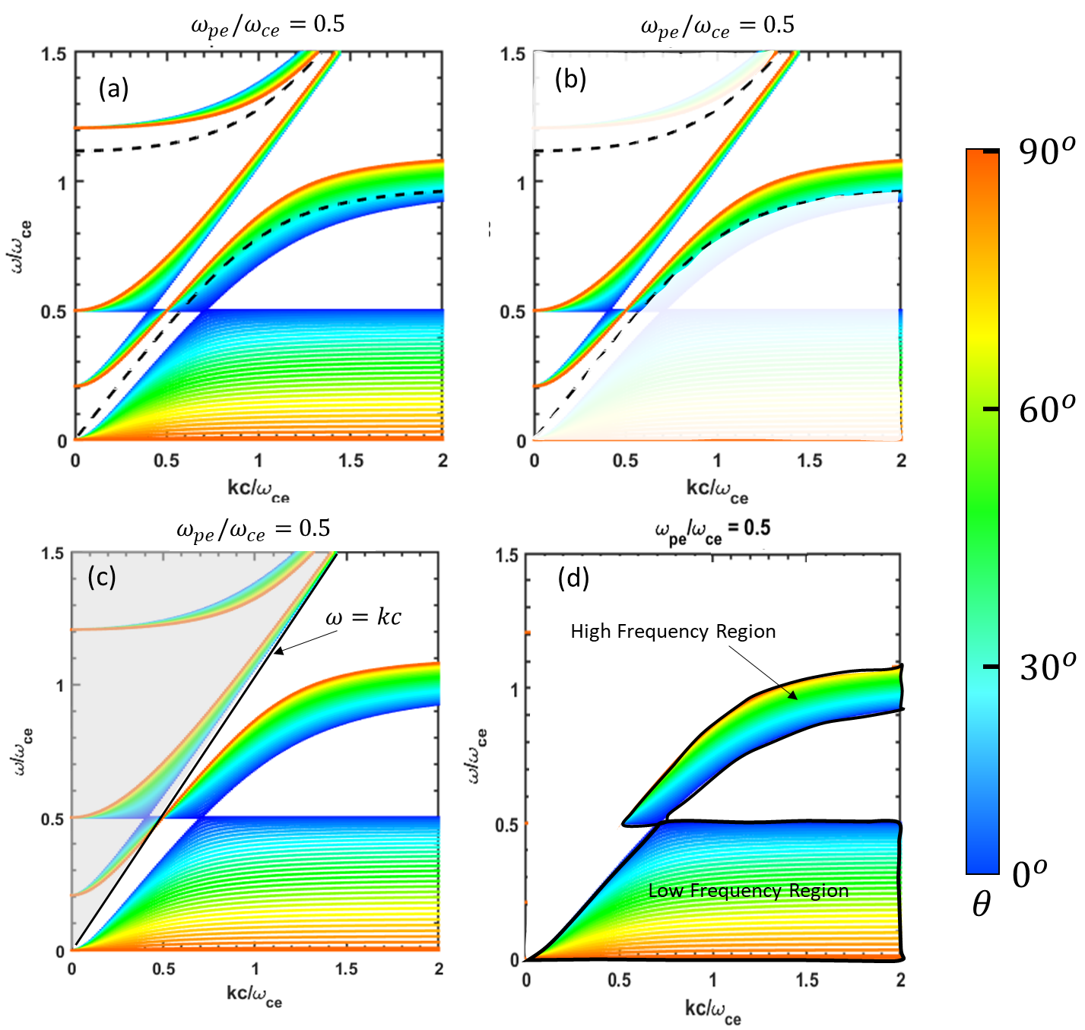
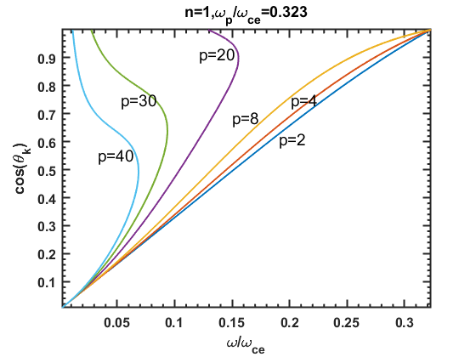

Slide 13
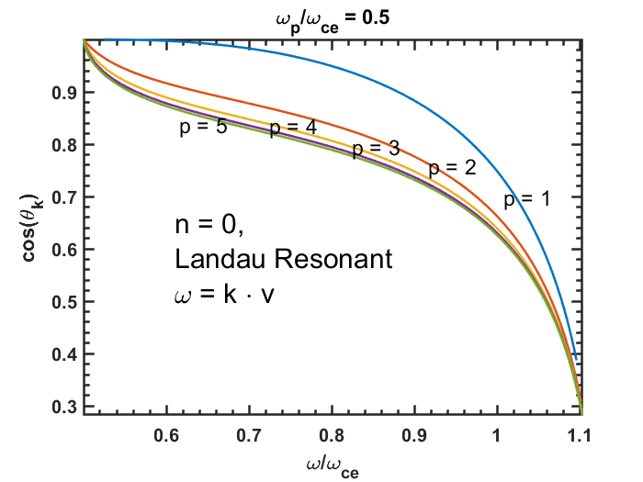
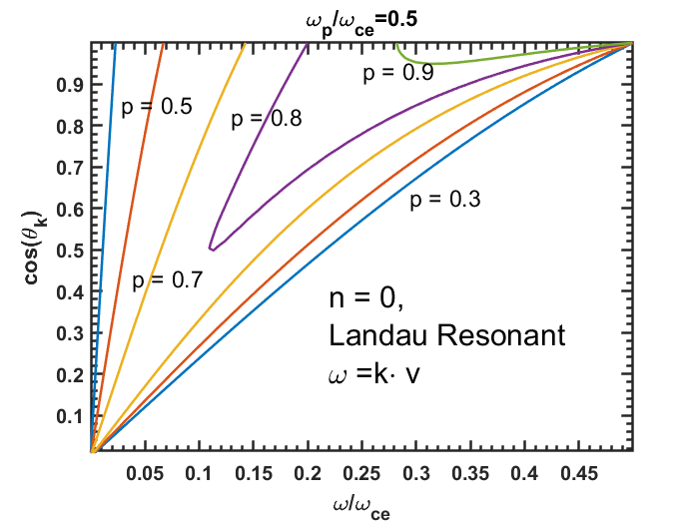
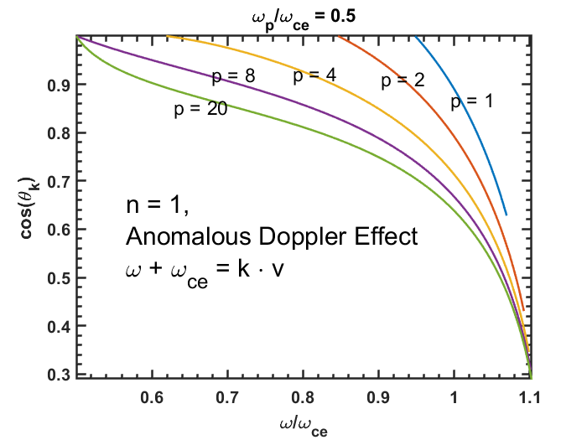
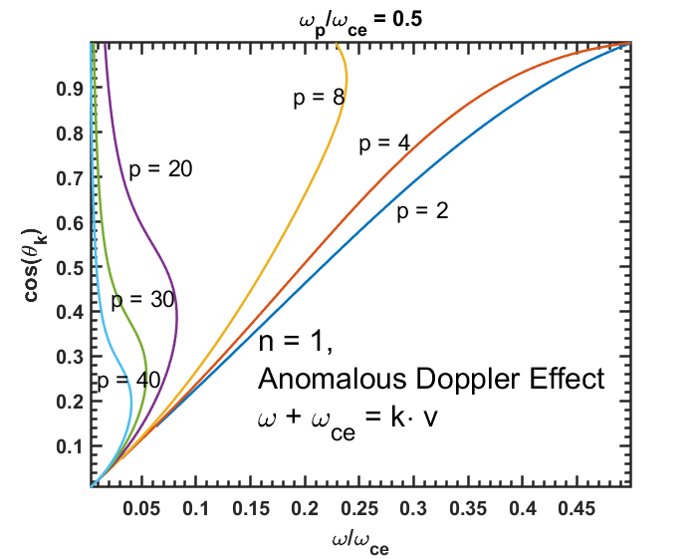
(a)
(b)
(c)
(d)

Slide 14
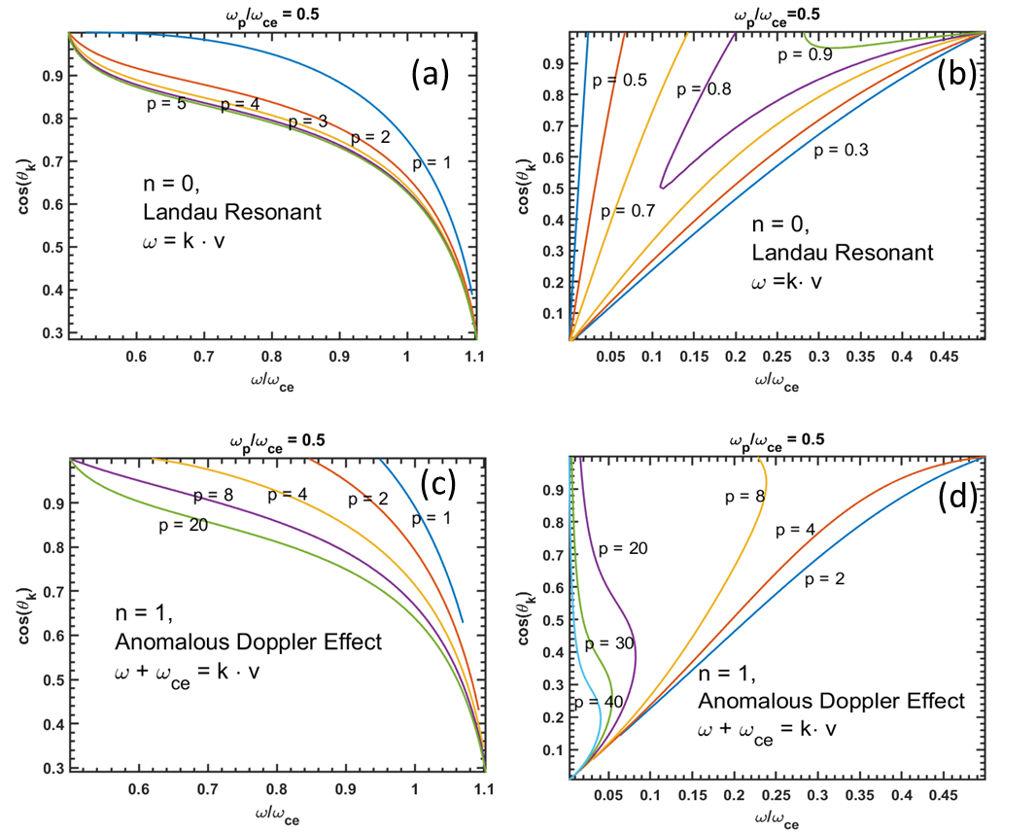
High frequency region
Low frequency region

Slide 15
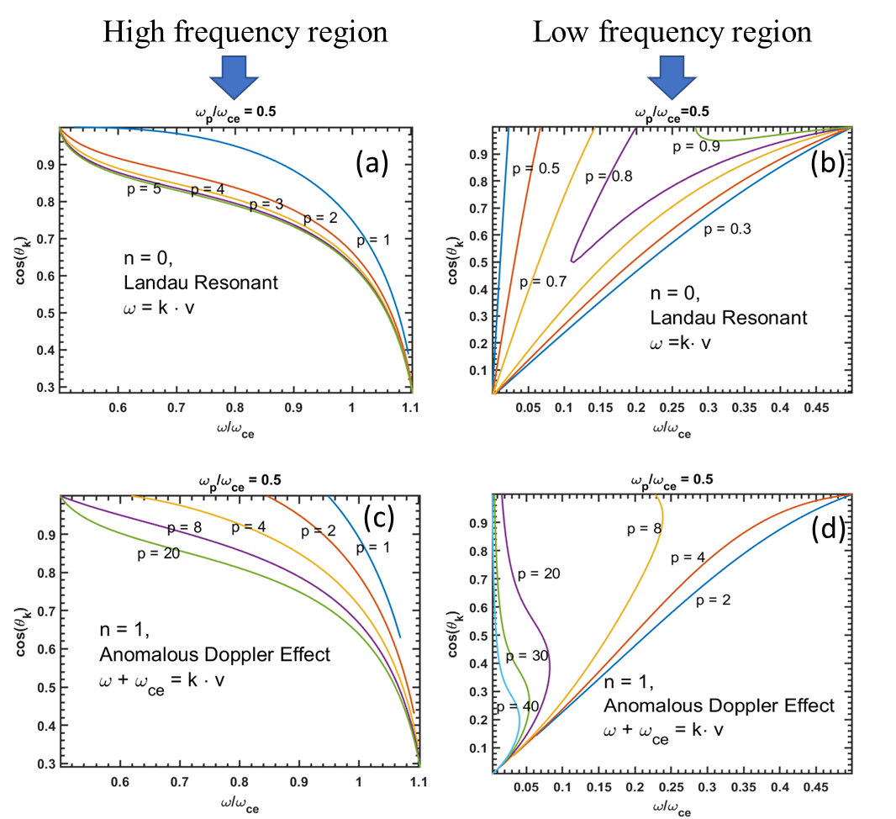
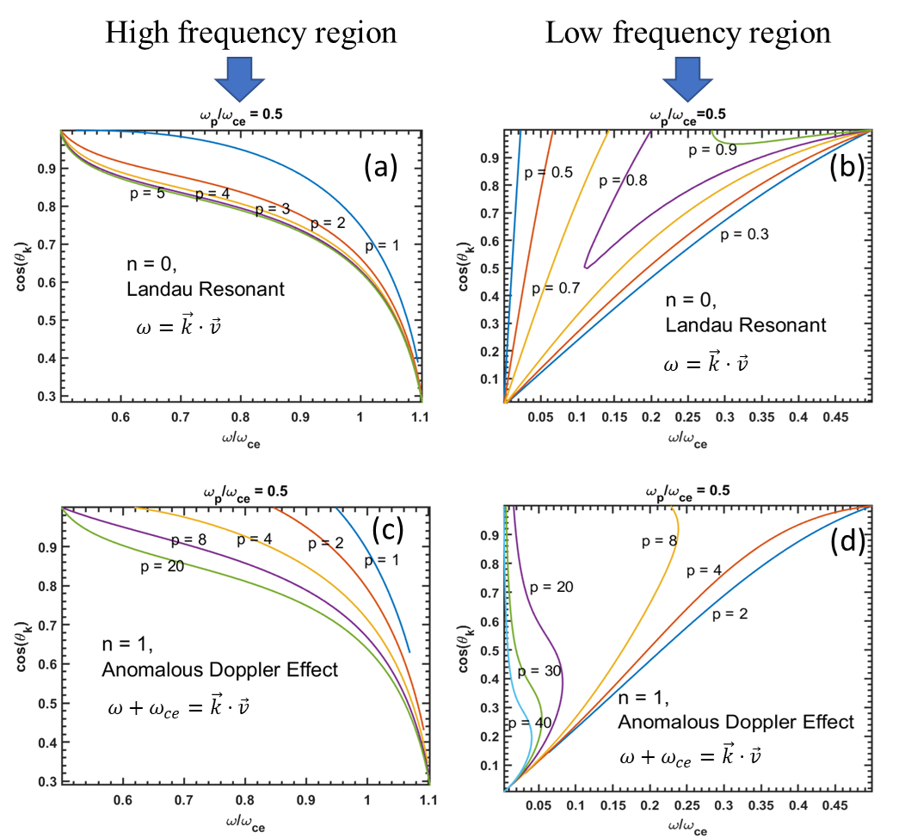
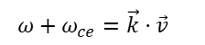


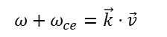


$$ω=\vec{k}⋅\vec{v}$$
$$ω=\vec{k}⋅\vec{v}$$
$$ω=\vec{k}⋅\vec{v}$$
$$ω=\vec{k}⋅\vec{v}$$
$$ω+ω_{ce}=\vec{k}⋅\vec{v}$$
$$ω+ω_{ce}=\vec{k}⋅\vec{v}$$

Slide 16
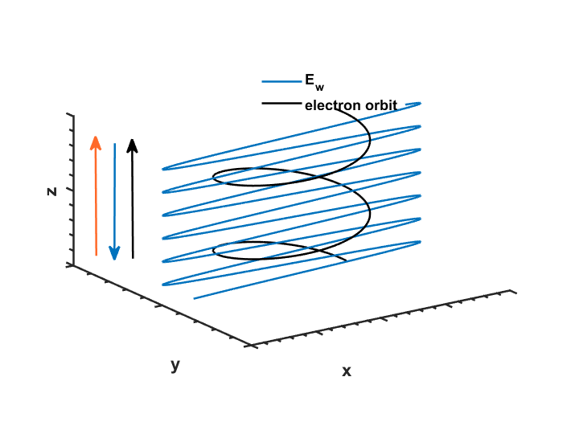
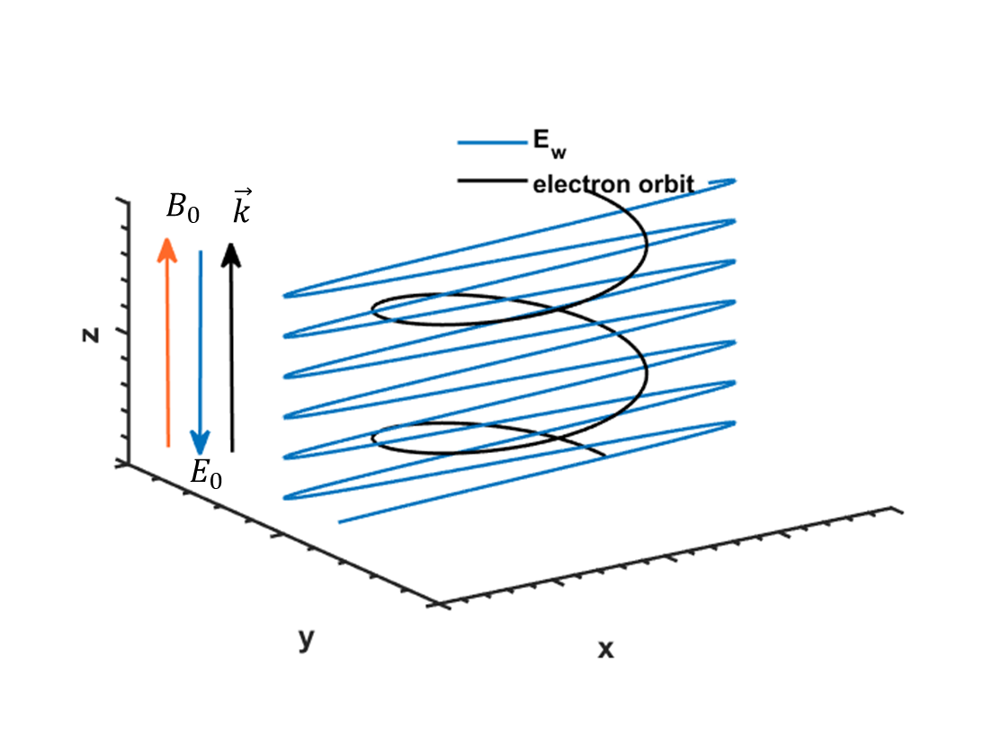
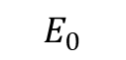


$$B_{0}$$
$$\vec{k}$$
$$E_{0}$$

Slide 17






U₂
B_{Z}
$$φ$$
U₁
$$v_{z2}$$
$$ℏω$$
$$v_{⊥2}$$
T₂
+
$$v_{z1}$$
$$v_{⊥1}$$
T₁

Slide 18



Slide 19


Normal Doppler Effect (NDE)
Anomalous Doppler Effect (ADE)

Slide 20




Slide 21





(a)
(b)
$$ω_{UH}/ω_{ce}$$
(c)
(d)
$$ω=kc$$
High Frequency Region
Low Frequency Region

Slide 22







$$θ_{k}(deg)$$
$$θ_{k}(deg)$$
(b)
(a)
(b)
$$ω_{UH}/ω_{ce}$$
$$θ_{k}(deg)$$
$$θ_{k}(deg)$$
(c)
(d)
$$ω=kc$$
High Frequency Region
Low Frequency Region

Slide 23




$$(a)$$
$$(b)$$
$$(c)$$

Slide 24


Slide 25



Slide 26


Slide 27













$$θ_{0}=arccos⁡(\frac{c^{′}}{v})$$
$$\vec{k}$$
Anomalous Doppler Effect (ADE)
$$θ$$
$$\vec{v}$$
Normal Doppler Effect (NDE)
$$Normal Doppler Effect (NDE)$$
$$Anomalous Doppler Effect (ADE)$$
$$Cerenkov cone$$
$$\vec{k}$$
$$θ_{0}$$
$$\vec{v}$$

Slide 28







$$z$$
$$B_{0}$$
$$E_{0}$$
$$k$$
$$y$$
$$x$$

